Slide 1
Big Data report

Slide 2
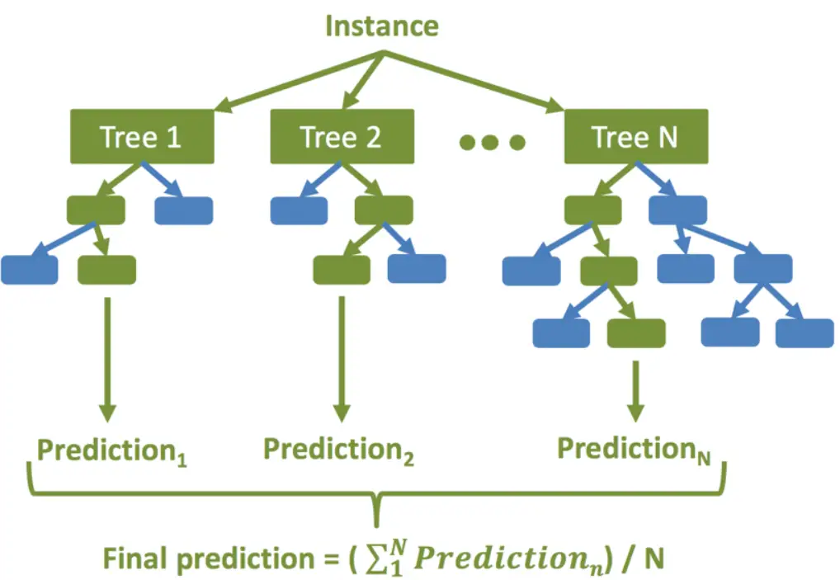
Random Forest Regression
meta estimator that fits a number of decision tree regressors on various sub-samples of the dataset and uses averaging to improve the predictive accuracy and control over-fitting.

Slide 3
Random Forest Regression
The high-level steps for random forest regression are as followings –
Decide the number of decision trees N to be created.
Randomly take K data samples from the training set by using the bootstrapping method.
Create a decision tree using the above K data samples.
Repeat steps 2 and 3 till N decision trees are created.
For the new unseen data predict regression results using each of the N decision trees. Then take an average of these results to arrive at the final regression output.

Slide 4
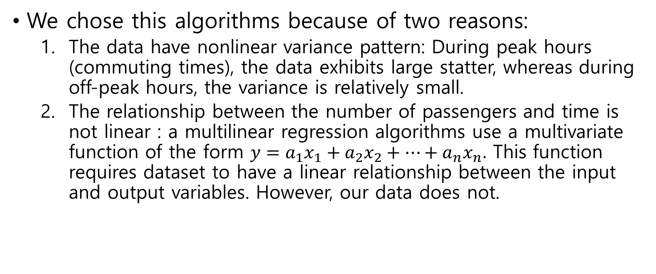
Random Forest Regression
We chose this algorithms because of two reasons:
The data have nonlinear variance pattern: During peak hours (commuting times), the data exhibits large statter, whereas during off-peak hours, the variance is relatively small.
The relationship between the number of passengers and time is not linear : a multilinear regression algorithms use a multivariate function of the form $y=a_{1}x_{1}+a_{2}x_{2}+…+a_{n}x_{n}.$ This function requires dataset to have a linear relationship between the input and output variables. However, our data does not.

Slide 5
Goal
Predict the number of people in a particular subway station at a particular line at a certain time
Inputs : Station name, Station line, Time, Temperature, Precipitation, An integer indicating whether the day is a weekday or a weekend or holiday, A boolean indicating whether passengers are riding or departing.
Output : A number of people riding/getting off the subway of a particular line

Slide 6
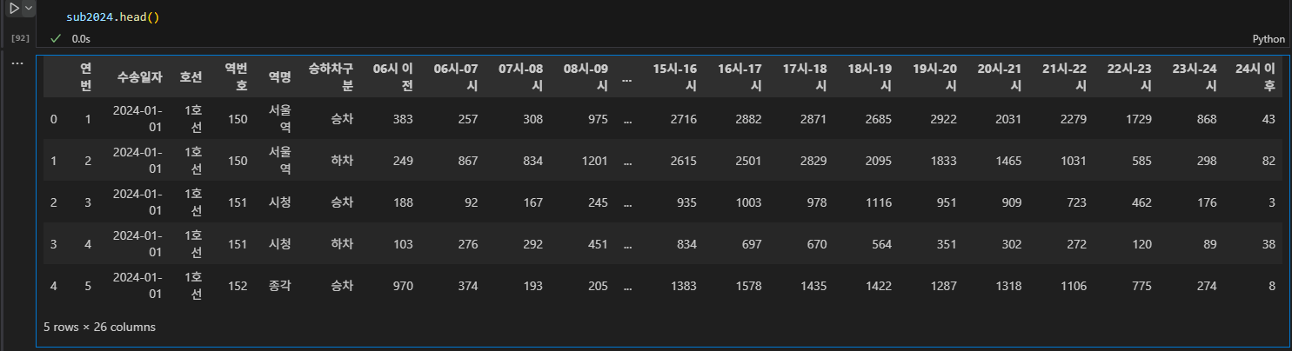
Results
Dataset
Subway 2022~2024 daily number of boarding/exiting people in hours by station & lines (1st line ~ 8th line)
We trained our model with a single station. (e.g. “Seoul station”, “Gangnam station”)
Obtained from https://data.seoul.go.kr/dataList/OA-12921/F/1/datasetView.do#

Slide 7
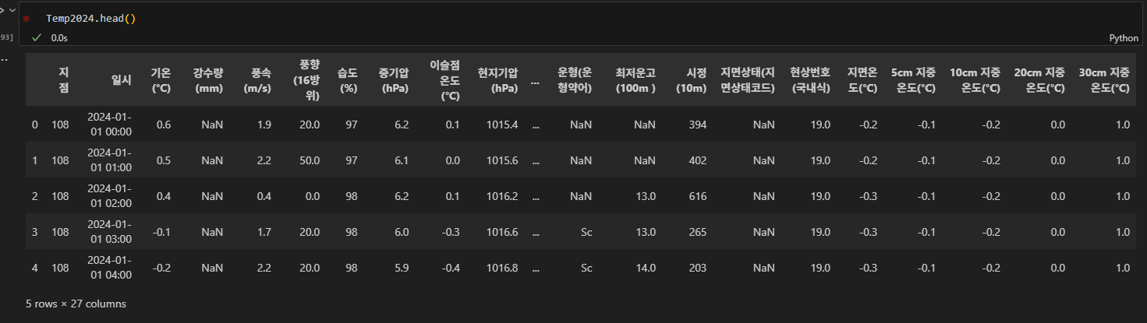
Results
Dataset
Hourly temperature & precipitation 2022 ~ 2024 data in Seoul
Obtained from https://data.kma.go.kr/data/grnd/selectAsosRltmList.do?pgmNo=36&tabNo=1

Slide 8
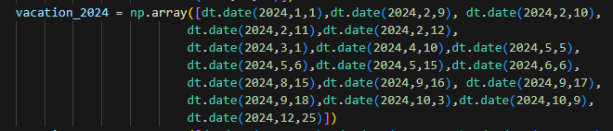
Random Forest Regression
Custom added dataset
Weekend value
0 : Weekdays (day = Mon, Tue…)
1 : Weekends (day = Sat, Sun)
2 : National holidays (day = Christmas…)
If the day is both weekend and national holiday, it is assigned 2.

Slide 9
Results
Used algorithm
Scikit-learn RandomForestRegressor
Scikit-learn GridSearchCV
Hyperparameters:
'n_estimators': [50, 100, 150],
'max_depth': [None, 10, 11, 15, 20],
'min_samples_split': [2, 5, 10],
'min_samples_leaf': [2, 4]
We used GridSearchCV to find the optimum combination of suggested parameters.

Slide 10
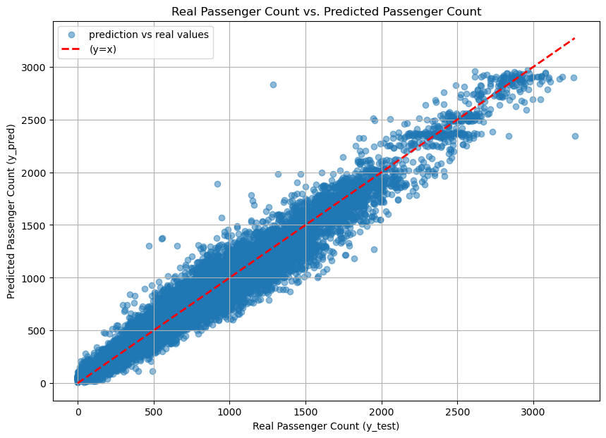
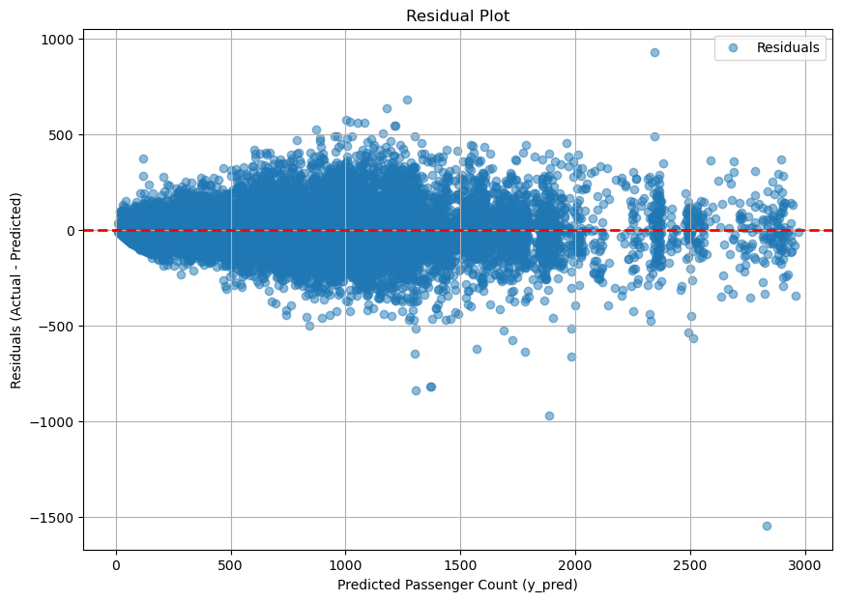

Results
Cheonho stn ‘천호(풍납토성)’ with Temp & Percipitation
$\sqrt{MSE}≈117.17$
Hyperparameters: {'max_depth': 15, 'min_samples_leaf': 2, 'min_samples_split': 10, 'n_estimators': 150}

Slide 11
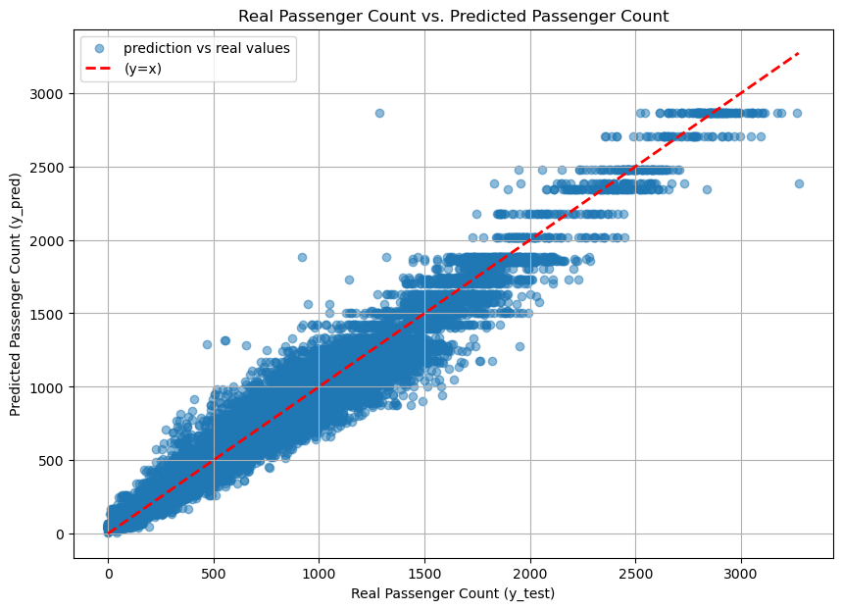
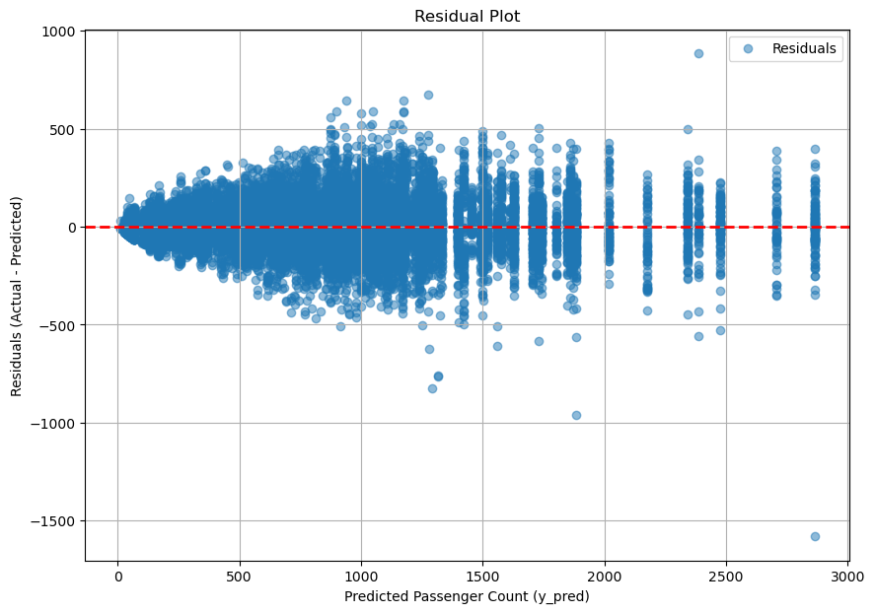

Cheonho stn ‘천호(풍납토성)’ without Temp & Percipitation
$\sqrt{MSE}≈\text{119.90}$
Hyperparameters : {'max_depth': None, 'min_samples_leaf': 4, 'min_samples_split': 10, 'n_estimators': 150}

Slide 12
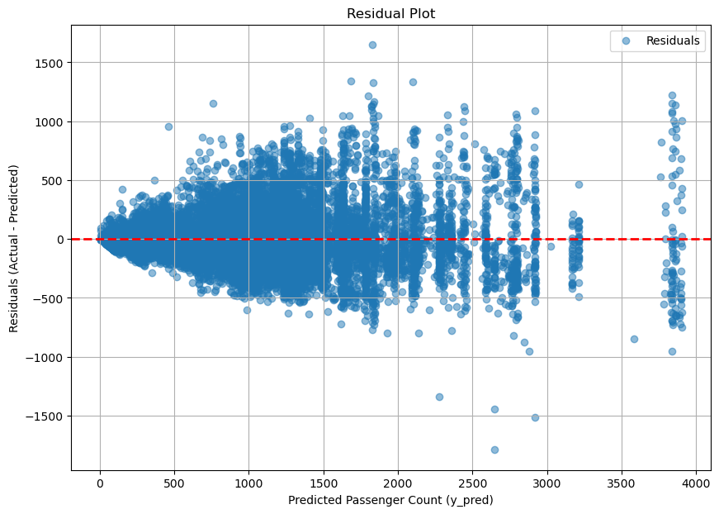
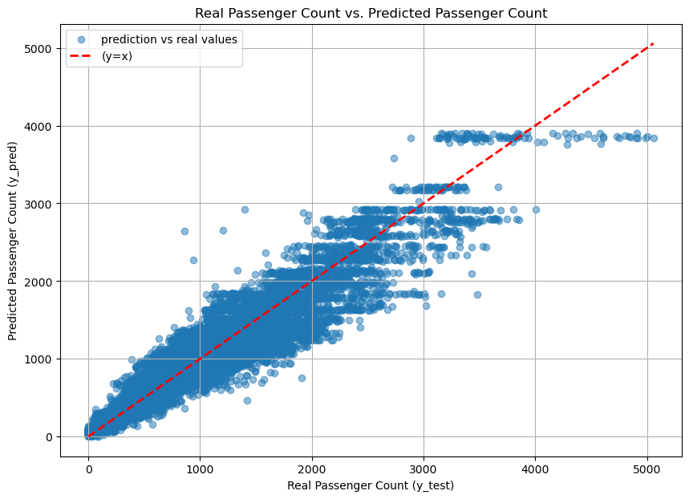

Nowon ‘노원’ with Temp & Percipitation
$\sqrt{MSE}≈\text{226.40}$
Hyperparameters:{'max_depth': 11, 'min_samples_leaf': 2, 'min_samples_split': 5, 'n_estimators': 150}

Slide 13
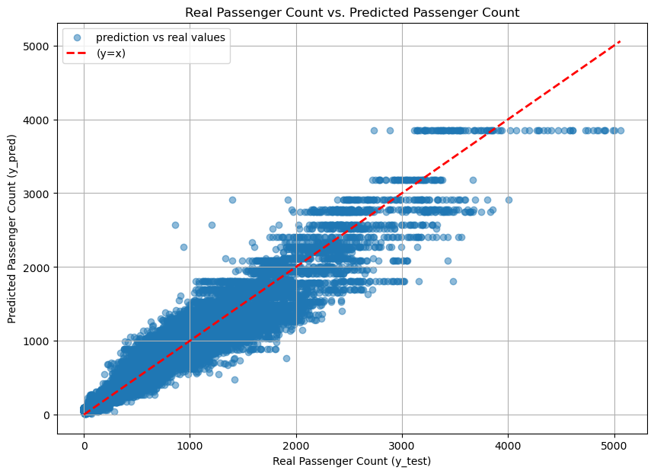
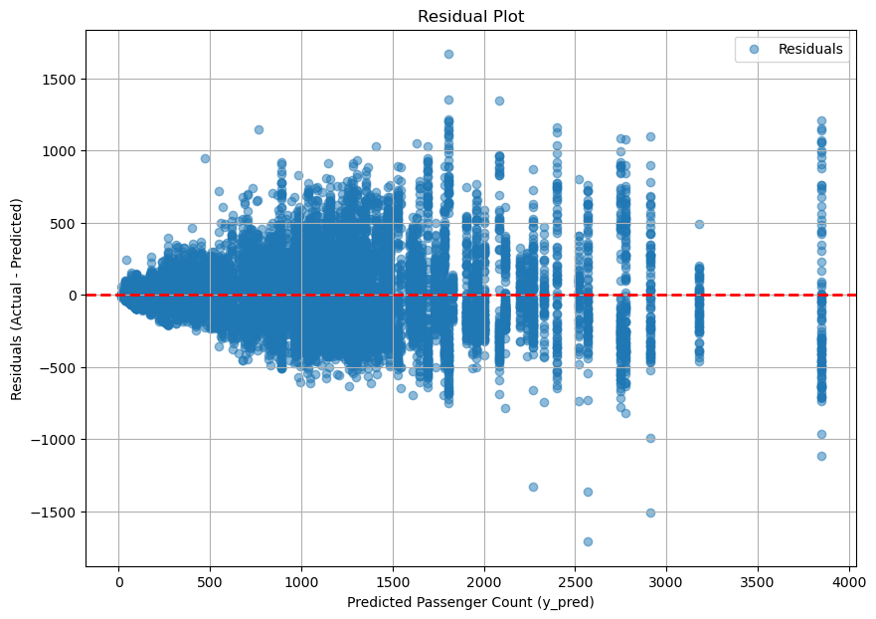

Nowon ‘노원’ without Temp & Percipitation
$\sqrt{MSE}≈\text{228.15}$
Hyperparameters:{'max_depth': 15, 'min_samples_leaf': 4, 'min_samples_split': 10, 'n_estimators': 150}

Slide 14
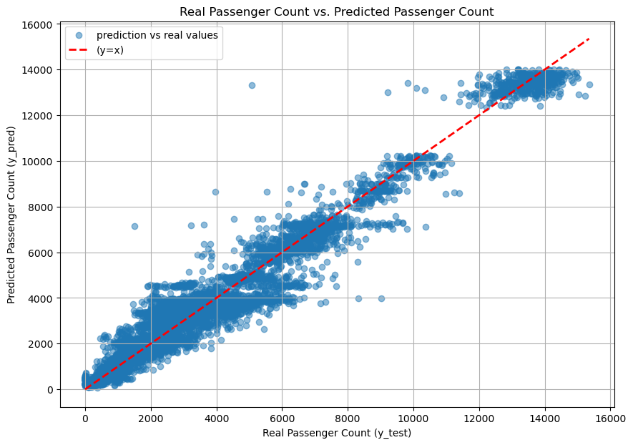
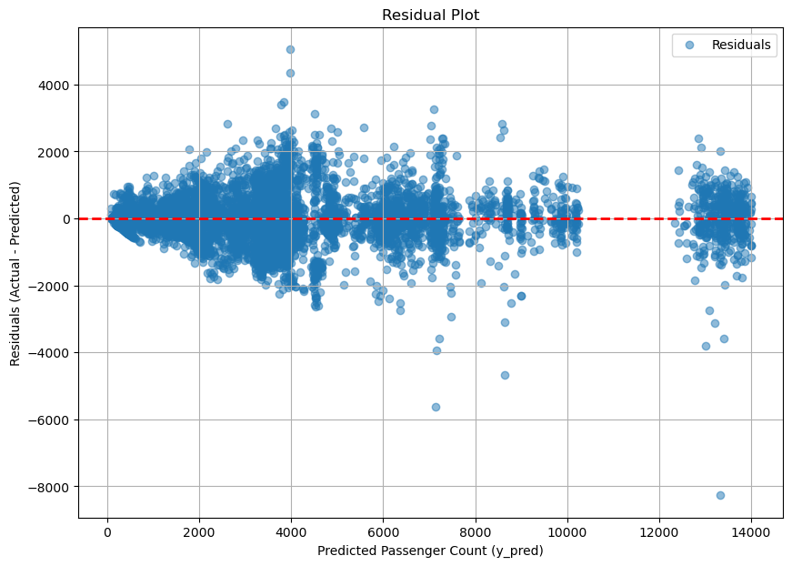

Results-Large commuters
Gangnam stn “강남” with Temp & Percipitation
$\sqrt{MSE}≈\text{643.66}$
Hyperparameters : {'max_depth': 11, 'min_samples_leaf': 4, 'min_samples_split': 10, 'n_estimators': 150}

Slide 15
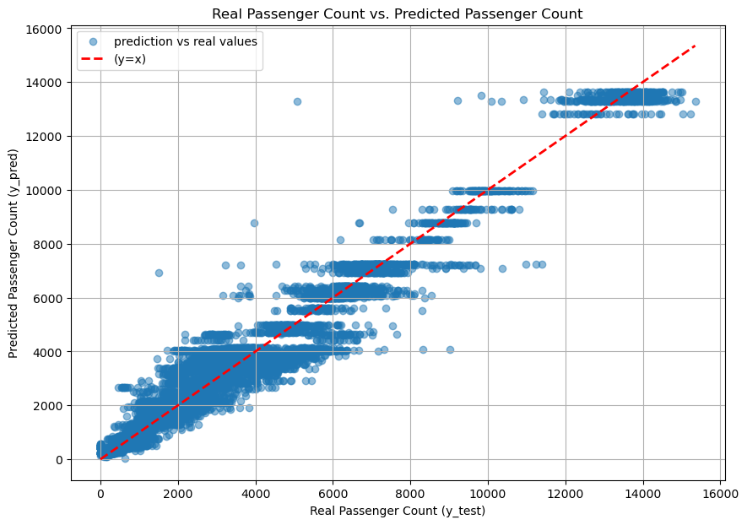
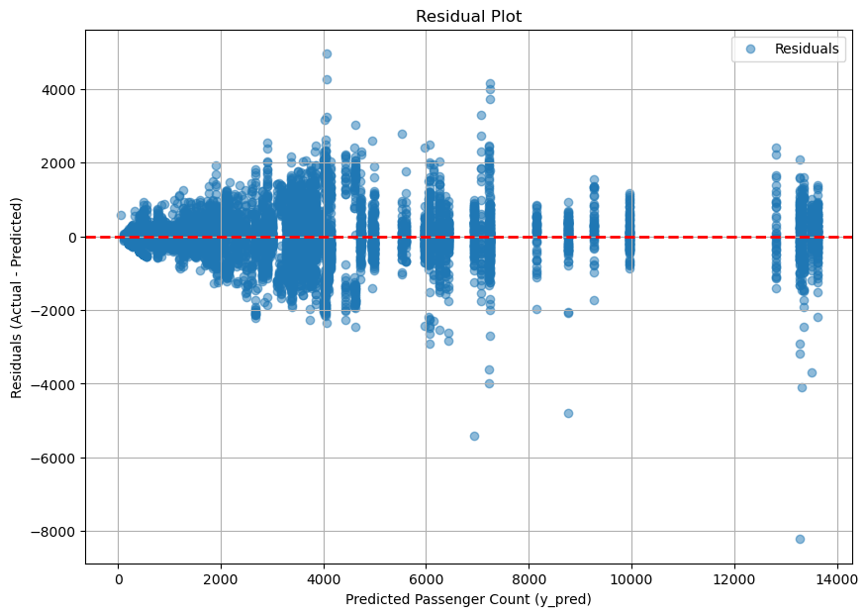

Results-Large commuters
Gangnam stn “강남” without Temp & Percipitation
$\sqrt{MSE}≈\text{651.96}$
Hyperparameters : {'max_depth': 11, 'min_samples_leaf': 4, 'min_samples_split': 10, 'n_estimators': 150}

Slide 16
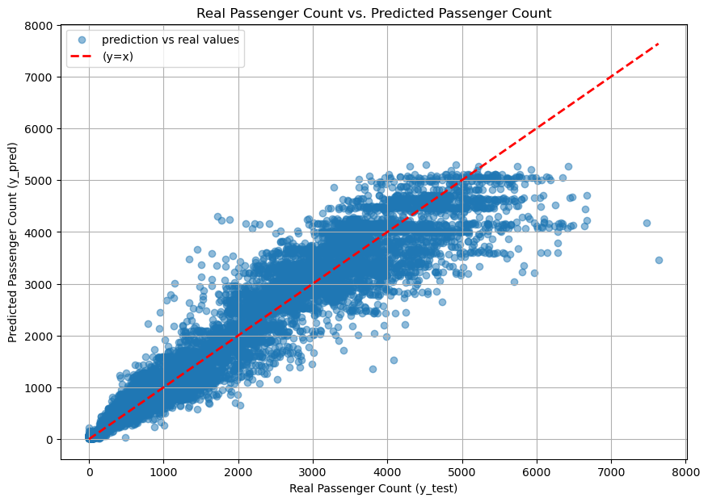
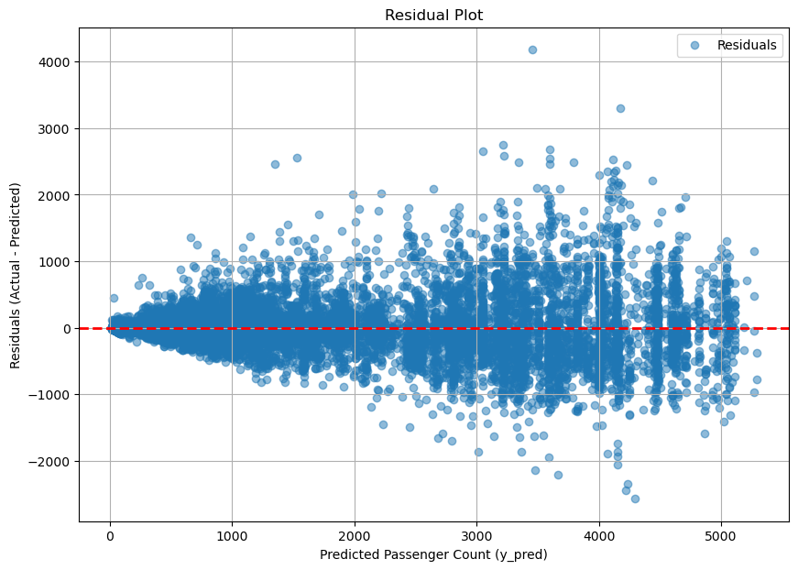

Results-Large commuters
Express Bus Terminal ‘고속터미널’
$\sqrt{MSE}≈\text{354.04}$
Hyperparameters: {'max_depth': 11, 'min_samples_leaf': 4, 'min_samples_split': 10, 'n_estimators': 150}

Slide 17
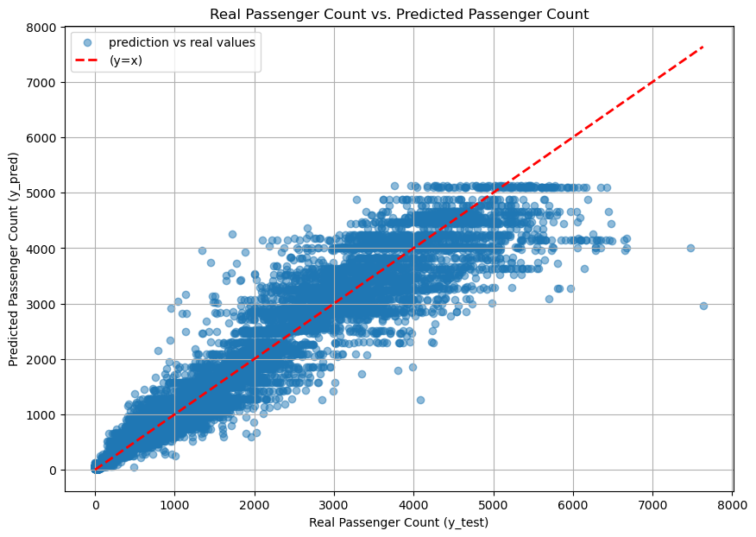
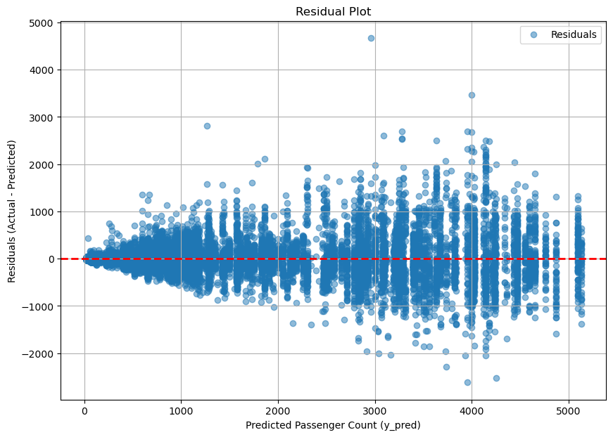

Results-Large commuters
Express Bus Terminal ‘고속터미널’ without Temp & Percipitation
$\sqrt{MSE}≈\text{360.18}$
Hyperparameters:{'max_depth': 11, 'min_samples_leaf': 4, 'min_samples_split': 10, 'n_estimators': 150}

Slide 18
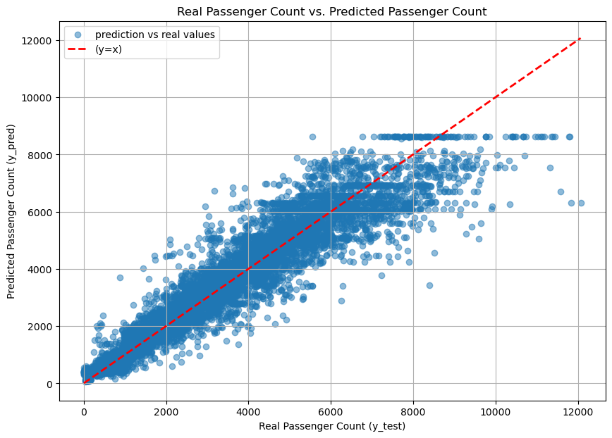
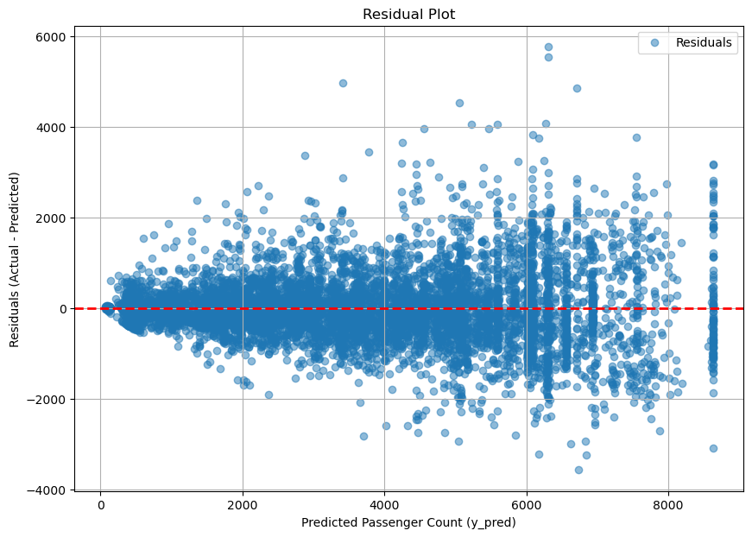

Hongik Univ ‘홍대입구’ with Temp & Percipitation
$\sqrt{MSE}≈\text{703.42}$
Hyperparameters:{'max_depth': 11, 'min_samples_leaf': 2, 'min_samples_split': 10, 'n_estimators': 150}

Slide 19
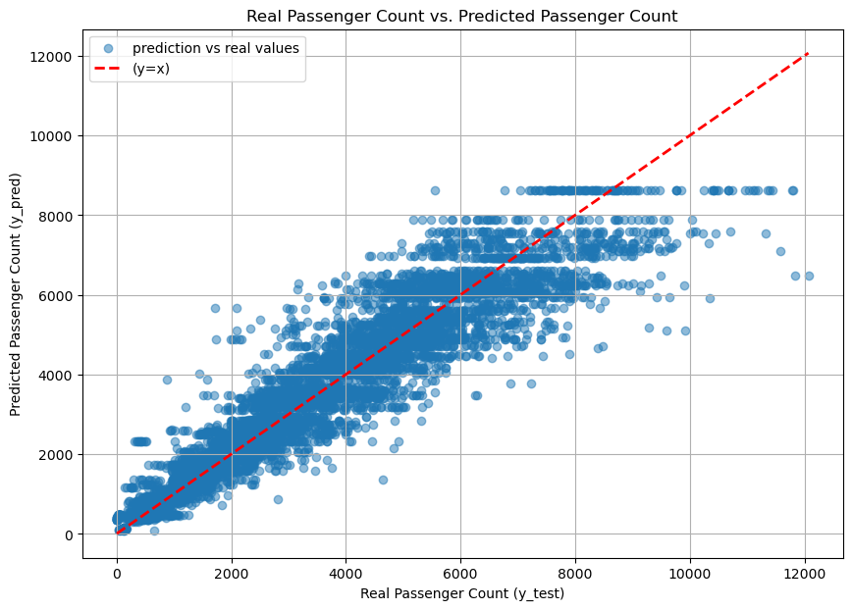
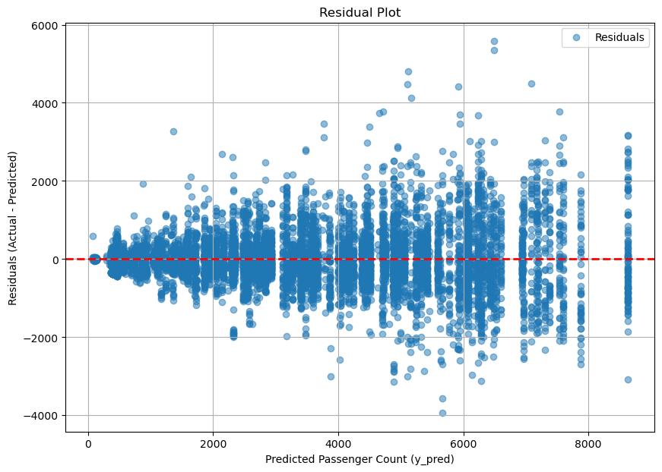

Hongik Univ ‘홍대입구’ without Temp & Percipitation
$\sqrt{MSE}≈\text{709.57}$
Hyperparameters: {'max_depth': None, 'min_samples_leaf': 2, 'min_samples_split': 10, 'n_estimators': 100}

Slide 20
Conclusion
We could fit the data within the error of a few 100 people
The regression for stations with fewer passengers gived a lower MSE
Conditions with fewer passengers showed small variance whereas larger passengers showed larger variance
Incorporating temperature and precipitation data helped smooth the distribution in the predicted vs real passenger count plot
Incorporating temperature and precipitation data resulted in a marginal decrease in MSE -> Not a critical parameter for people to prefer using a subway.

